Slide 1
Containers in HPC and Beyond
Andrew J. Younge
Sandia National Laboratories
ajyoung@sandia.gov
Unclassified Unlimited Release
SAND2019-4001 C

Slide 2
Outline
Motivation
Why containers in HPC
Developing Container vision
Initial investigation of Singularity on Cray
HPC apps on production DOE/NNSA clusters
DOE ECP Supercontainers Project
Supporting containers at Exascale
Future Directions & Conclusions

Slide 3
Initial Container Vision
Support software dev and testing on laptops
Working builds that can run on supercomputers
Dev time on supercomputers is extremely expensive
May also leverage VM/binary translation
Let developers specify how to build the environment AND the application
Users just import a container and run on target platform
Many containers, but can have different code “branches” for arch, compilers, etc.
Not bound to vendor and sysadmin software release cycles
Want to manage permutations of architectures and compilers
x86 & KNL, ARMv8, POWER9, etc.
Intel, GCC, LLVM
Performance matters!
Use HPC to “shake out” container implementations on HPC
Keep features to support future complete workflows
Notes:
Caveat: you are your own helpdesk or support services

Slide 4
Containers in HPC
BYOE - Bring-Your-Own-Environment
Developers define the operating environment and system libraries in which their application runs
Composability
Developers explicitly define how their software environment is composed of modular components as container images
Enable reproducible environments that can potentially span different architectures
Portability
Containers can be rebuilt, layered, or shared across multiple different computing systems
Potentially from laptops to clouds to advanced supercomputing resources
Version Control Integration
Containers integrate with revision control systems like Git
Include not only build manifests but also with complete container images using container registries like Docker Hub

Slide 5
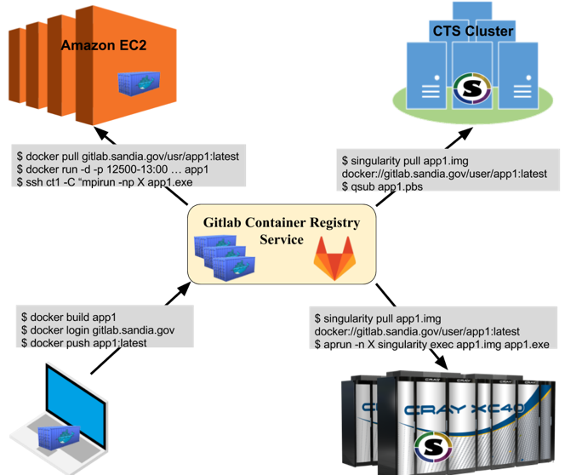
Container DevOps
Impractical for apps to use large-scale supercomputers for DevOps and testing
HPC resources have long batch queues
Dev time commonly delayed as a result
Create deployment portability with containers
Develop Docker containers on your laptop or workstation
Leverage registry services
Separate networks maintain separate registries
Import to target deployment
Leverage local resource manager

Slide 6

Singularity Containers
Many different container options
Docker, Shifter, Singularity, Charliecloud, etc. etc.
Docker is not good fit for running HPC workloads
Security issues, no HPC integration
Singularity best for current mission needs
OSS, publicly available, support backed by Sylabs
Simple image plan, support for many HPC systems
Docker image support
Multiple architectures (x86, ARM, POWER)
Large community involvement

Slide 7
Singularity on a Cray (in 17’)
Crays can represent pinnacle of HPC
4 of the 10 fastest supercomputers are Cray (Nov 17 Top500)
Cray systems are different than Linux clusters
Specialized compute OS, no node-local storage, custom interconnect, specialized and tuned libraries, etc
Modified Cray CNL kernel to build in necessary features
Loop mounting and EXT3 support, soon SquashFS and Overlay
Create /opt/cray and /var/opt/cray mounts on all images
Use LD_LIBRARY_PATH to link in Cray system software
XPMEM, CrayMPI, uGNI, etc
Now much easier – just install RPM from Sylabs
How does running Singularity on a Cray compare to Docker on a Cloud?
Notes:
Leveraging Vendor MPI libraries matters!
Using IntelMPI has ~18% perf degradation
Using KVM with MPICH only has ~10% perf degradation
Amazon Cloud useful for small scale, but not performant beyond just a few nodes.

Slide 8
Tale of Two Systems
Volta
Amazon EC2
Cray XC30 system
NNSA ASC testbed at Sandia
56 nodes:
2x Intel ”IvyBridge” E5-2695v2 CPUs
24 cores total, 2.4Ghz
64GB DDR3 RAM
Cray Aries Interconnect
No local storage, Shared DVS filesystem
Singularity 2.X
Cray CNL ver. 5.2.UP04
Based on SUSE 11
3.0.101 kernel
32 nodes used to keep equal core count
Common public cloud service from AWS
48 c3.8xlarge instances:
2x Intel “IvyBridge” E5-2680 CPUs
16 cores total 32 vCPUs (HT), 2.8Ghz
10 core chip (2 cores reserved by AWS)
60 GB RAM
10 Gb Ethernet network w/ SR-IOV
2x320 SSD EBS storage per node
RHEL7 compute image
Docker 1.19
Run in dedicated host mode
48 node virtual cluster = $176.64/hour
Notes:
Run Volta in many modes: VMs, Containers, and Native, and static-linked binaries
c3.8xlarge is not directly equivalent to Volta’s architecture,
Difference are cores per node, and operating frequency.
However, it provides the closest possible comparison between architectures and both use the same CPU architecture.

Slide 9
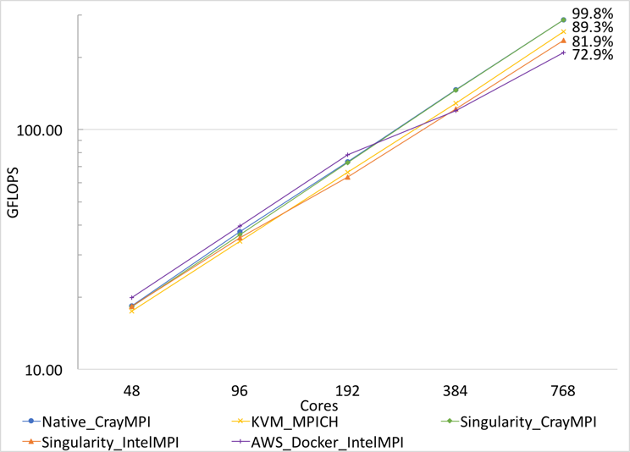
HPCG VMs and container performance
Modified Cray XC testbed to run Singularity containers
Create /opt/cray and /var/opt/cray on all images
Link in Cray system software
XPMEM, CrayMPI, uGNI, etc
HPCG Benchmark in Container
Compare Singularity on Cray
Compare KVM on Cray
Compare Amazon EC2
Younge et. al, A Tale of Two Systems: Using Containers to Deploy HPC Applications on Supercomputers and Clouds, IEEE CloudCom 2017
Notes:
Leveraging Vendor MPI libraries matters!
Using IntelMPI has ~18% perf degradation
Using KVM with MPICH only has ~10% perf degradation
Amazon Cloud useful for small scale, but not performant beyond just a few nodes.

Slide 10
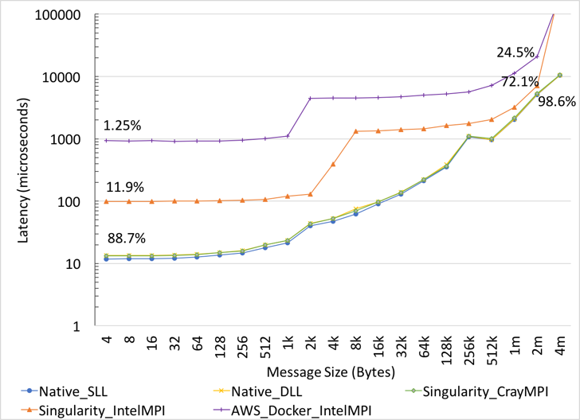
Container MPI Performance
IMPI All-Reduce benchmark
Some overhead in dynamic linking of apps
~1.6us latency
Independent of containers
Large messages hide latency
1 order of magnitude difference with Intel MPI
2 orders of magnitude difference with Amazon EC2
Younge et. al, A Tale of Two Systems: Using Containers to Deploy HPC Applications on Supercomputers and Clouds, to appear in IEEE CloudCom 2017

Slide 11
From Testbeds to Production

Slide 12
From Testbeds to Production
Demonstrated containers on a Cray XC30 w/ Singularity
Performance can be near native
Leveraging vendor libraries within a container is critical
Cray MPI on Aries most performant
Confirming similar results from Shifter
Container and library interoperability is key moving forward
Vendor provided base containers desired
Community effort on library ABI compatibility is necessary
Initial benchmarks and mini-apps, what about production apps?
Can NNSA mission applications use containers?
Can production/facilities teams build container images?
What are key metrics for success?
How will containers work in “air gapped” environments?

Slide 13

System Description
SNL Doom:
CTS-1 HPC platform
Dual E5-2695 v4 (Broadwell) processors, with AVX2, per node
18 cores (36 threads) per processor, 36 cores (72 threads) total per node
Core base frequency 2.1 GHz, 3.3 GHz max boost frequency
32 KiB instruction, 32 KiB data L1 cache per core
256 KiB unified (instruction + data) L2 cache per core
2.5 MB shared L3, 45 MiB L3 per processor
4 memory channels per processor (8 per node)
DDR4 2400 MHz/s
512 GB per node
Intel Omni-Path HFI Silicon 100 Series (100 Gb/s adapter) for MPI communications
CTS-1 Platform Is Relevant to the Tri-Labs for Production HPC Workloads

Slide 14
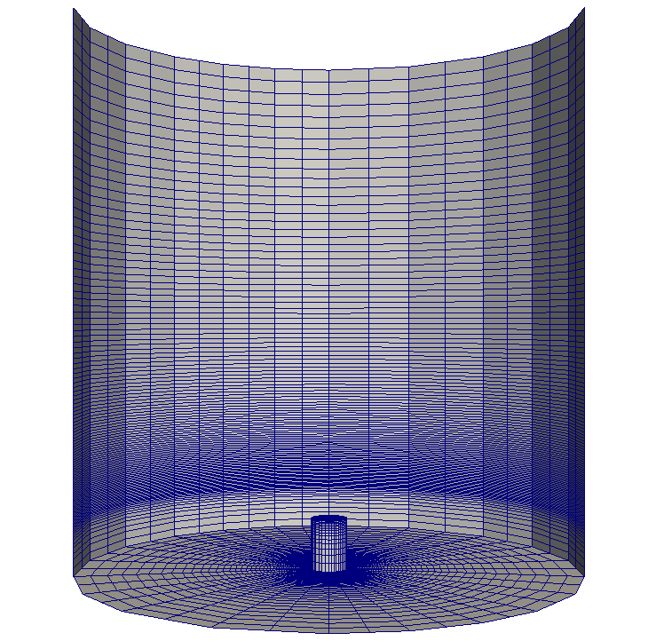
Problem Description
SNL Nalu:
A generalized unstructured massively parallel low Mach flow code designed to support energy applications of interest [1]
Distributed on GitHub under 3-Clause BSD License [2]
Leverages the SNL Sierra Toolkit and Trilinos libraries
Similar to bulk of SNL Advanced Simulation and Computing (ASC) Integrated Codes (IC) and Advanced Technology, Development, and Mitigation (ATDM) project applications
Milestone Simulation:
Based on “milestoneRun” regression test [3] with 3 successive levels of uniform mesh refinement (17.2M elem.), 50 fixed time steps, and no file system output
Problem used for Trinity Acceptance [4] and demonstrated accordingly on Trinity HSW [5] and KNL [6], separately, at near-full scale
S. P. Domino, "Sierra Low Mach Module: Nalu Theory Manual 1.0", SAND2015-3107W, Sandia National Laboratories Unclassified Unlimited Release (UUR), 2015. https://github.com/NaluCFD/NaluDoc
“NaluCFD/Nalu,” https://github.com/NaluCFD/Nalu, Sep. 2018.
“Nalu/milestoneRun.i at master,” https://github.com/NaluCFD/Nalu/blob/master/reg_tests/test_files/milestoneRun/milestoneRun.i, Sep. 2018.
A. M. Agelastos and P. T. Lin, “Simulation Information Regarding Sandia National Laboratories’ Trinity Capability Improvement Metric,” Sandia National Laboratories, Albuquerque, New Mexico 87185 and Livermore, California 94550, Technical report SAND2013-8748, October 2013.
M.Rajan, N.Wichmann, R.Baker, E.W.Draeger, S.Domino, C. Nuss, P. Carrier, R. Olson, S. Anderson, M. Davis, and A. Agelastos, “Performance on Trinity (a Cray XC40) with Acceptance Applications and Benchmarks,” in Proc. Cray User’s Group, 2016.
A. M. Agelastos, M. Rajan, N. Wichmann, R. Baker, S. Domino, E.W. Draeger, S. Anderson, J. Balma, S. Behling, M. Berry, P. Carrier, M. Davis, K. McMahon, D. Sandness, K. Thomas, S. Warren, and T. Zhu, “Performance on Trinity Phase 2 (a Cray XC40 utilizing Intel Xeon Phi processors) with Acceptance Applications and Benchmarks,” in Proc. Cray User’s Group, 2017.

Slide 15
Performance Testing Description
Test Characteristics:
Strong scale problem
36 MPI ranks per node
No threading
Bind ranks to socket
Measure the the `mpiexec` process wall time for both native and container simulations
Extract the maximum resident set size (MaxRSS) for the `mpiexec` process and all of its sub-processes on the head node for both native and container simulations
We want to gather all overhead the Singularity container runtime imposes over a native simulation
The tested methodology for the Singularity container simulation is:
mpiexec -> singularity exec -> bash -> nalu
Extract the maximum resident set size (MaxRSS) for all of the Nalu MPI processes across all nodes and compute the “average” MaxRSS for Nalu
This value is computed for both the native and container simulations so that the former can be subtracted from the latter to compute the container overhead
This was extracted via LDPXI using LD_PRELOAD to attach to the native and containerized Nalu processes; LDPXI extracts this via ru_maxrss from getrusage() at the end of the simulation
Wall Time and Memory Are Key Performance Parameters for Production Workloads

Slide 16
Build & Environment Description
Doom Software Stack:
TOSS 3.3-1 (~RHEL 7.5)
gnu-7.3.1, OpenMPI 2.1.1
hwloc-1.11.8
Container Software Stack:
CentOS 7.5.1804 (~RHEL 7.5)
gnu-7.2.0, OpenMPI 2.1.1
hwloc-1.11.1
olv-plugin
Nalu Dependencies:
zlib-1.2.11
bzip2-1.0.6
boost-1.65.0
hdf5-1.8.19
pnetcdf-1.8.1
netcdf-4.4.1
parmetis-4.0.3
superlu_dist-5.2.2
superlu-4.3
suitesparse-5.1.0
matio-1.5.9
yaml-cpp-0.5.3
Trilinos-develop-7c67b929
Nalu-master-11899aff
Open Source Software Stack Enables Greater Collaboration and Testing Across Networks and Systems

Slide 17
Younge et. al, (U) Quantifying Metrics to Evaluate Containers for Deployment and Usage of NNSA Production Applications, NECDC 2018

Slide 19
Nalu Container Analysis
The container was faster, but used more memory?!
Dynamic linking of GCC 7.2 in container vs system GCC 4.8 Memory usage
Memory differences: gfortran & stdlibc++ libraries
GCC 7.2 libs much larger, ~18MB total
Performance differences: OpenMPI libs
Container’s OpenMPI w/ GCC7 provides usempif08 in OpenMPI
usempif08 includes MPI3 optimizations vs MPI2 with usempi
Position Independent Code (-fPIC) used throughout container compiles
Provides larger .GOT in memory, but often slightly improved performance on x86_64
Overhead with using bash in container to load LD_LIBRARY_PATH before exec
Constant but small, depends on .bashrc file
Demonstrates both the power and pitfalls of building your own HPC application environment in containers

Slide 20
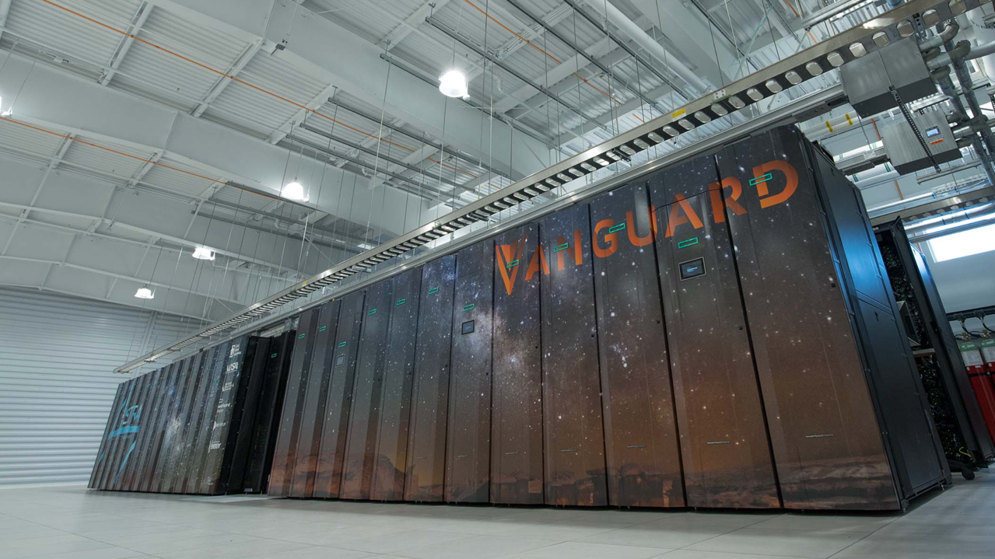


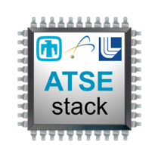
The world’s First Petascale Arm Supercomputer
Now running Singularity 3
2.3 PFLOPs peak
>5000 TX2 CPUs, ~150k cores 885 TB/s memory bandwidth peak
332 TB memory
1.2 MW

Slide 21
Containers on Secure Networks
Containers are primarily built on unclassified systems then moved to “air gapped” networks via automated transfers
Cybersecurity approvals in place to run containers on all networks
Security controls used in running containers on HPC systems
Working to validate software compliance
Automated Transfer Services to air gapped networks
Challenges of automated transfers
Size – 5GB-10GB are ideal
Integrity – md5 is enough
Availability – who are you competing against?
Transfer policies – executables, code, etc.
Containers will fully work with automated transfers for use in air gapped networks
Notes:
Much of Sandia's development work is performed on the unclassified networks. The resulting work is transferred to the classified networks in which additional code (classified) is compiled in, is recompiled against classified libraries, or the executable is run against classified data. Two automated processes exist at Sandia for sending data from the unclassified network to the classified network. These automated processes take a file or files from the unclassified network and make them available on the classified network. For brevity we assume that the file meets any of the transfer policy requirements such as: allowed file types (for example no executables or active content), is virus scanned, or any other. We also further assume that the upload onto the unclassified transfer server and the download from the classified transfer server are accomplished in an automated way. Typically non-user or service accounts are needed to perform the automated upload and download.

Slide 22

Towards the DOE ECP Supercontainer Project

Slide 23



Containers at Exascale
Containers have gained significant interest throughout the ECP
There exists several container runtimes for HPC today
Shifter, Singularity, Charliecloud
Diversity is good!
Containers can provide greater software flexibility, reliability, ease of deployment, and portability
Several likely challenges to containers at Exascale:
Scalability
Resource management
Interoperability
Security
Further integration with HPC (batch jobs, Lustre, etc)
Q: What is the ECP?
A: The Exascale Computing Project (ECP) is focused on accelerating the delivery of a capable exascale computing ecosystem that delivers 50 times more computational science and data analytic application power than possible with DOE HPC systems such as Titan (ORNL) and Sequoia (LLNL). With the goal to launch a US Exascale ecosystem by 2021, the ECP will have profound effects on the American people and the world.
The ECP is a collaborative effort of two U.S. Department of Energy organizations – the Office of Science (DOE-SC) and the National Nuclear Security Administration (NNSA).

Slide 24
ECP Supercontainers Project
Joint effort across Sandia, LANL, LBNL, U. of Oregon
Ensure container runtimes will be scalable, interoperable, and well integrated across the DOE
Enable container deployments from laptops to Exascale
Help ECP applications and facilities leverage containers most efficiently
Three-fold approach:
Scalable R&D activities
Collaboration with related ST and interested AD projects
Training, Education, and Support
Activities conducted in the context of interoperability
Portable solutions
Containerized ECP that runs on NERSC9, A21, El-Capitan, …
Work for multiple container implementations
Not picking a “winner” container runtime
Multiple DOE facilities at multiple scales
Notes:
Not select a “winning” runtime, but help users and facilities select

Slide 25

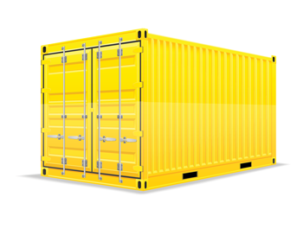
Moving Forward
Several activities to broaden adoption of containers
Define best practices for HPC containers
Refine container DevOps model
Include CI/CD pipelines
Multi-stage builds & enhanced package management
Facilities supported base container images
Validate interoperability at scale
Increase integration with larger community
Ensure ABI compatibility however possible
Engage with vendors & HPC facilities
Lead standardization effort where applicable
Explore novel workflows & ensembles withHPC

Slide 26

Conclusion
Demonstrated value of container models in HPC
Deployments in testbeds to production HPC
Initial DevOps appealing to scientific software development
Initial performance is good
ECP Supercontainers
Performance validated at Exascale
Embrace diversity while insuring interoperability
Integration with larger ECP ecosystem
Community involvement will be critical for success

Slide 27


Thanks! ajyoung@sandia.gov
14th Workshop on Virtualization in High-Performance Cloud Computing (VHPC'19) @ ISC19 in Frankfurt, DE
Papers due May 1st - vhpc.org
HPCW19 @ ISC19 - qnib.org/isc
Students, Postdocs, Collaborators…

Slide 28
Backup Slides

Slide 29
Advanced
Containers must work at Exascale
DOE ECP efforts are depending on it
Embrace architectural diversity
Containerized CI/CD pipeline with Gitlab
HPC service orchestration
Build-time optimizations
Entire ECP software stack in container
Multi-stage builds
Spack & pkg mgmt orchestration
Further integration with larger community needed
Decrease reliance on MPI ABI compatibility
Vendor support for base containers images
Foster standards that increase reliability and
Workflow ensemble support
Reproducibility?

Slide 30
Acceptance Plan – Maturing the Stack
Notes:
Track performance over time
Want to have two compiler and two MPI options at milestone 2.

Slide 31



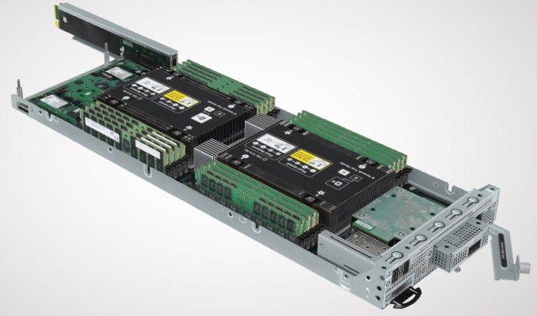
Vanguard-Astra Compute Node Building Block
Dual socket Cavium Thunder-X2
CN99xx
28 cores @ 2.0 GHz
8 DDR4 controllers per socket
One 8 GB DDR4-2666 dual-rank DIMM per controller
Mellanox EDR InfiniBand ConnectX-5 VPI OCP
Tri-Lab Operating System Stack based on RedHat 7.5+
HPE Apollo 70 Cavium TX2 Node
Notes:
Might note no storage on node. Could add later. Two NVMe slots per node for M.2 drives.

Slide 32
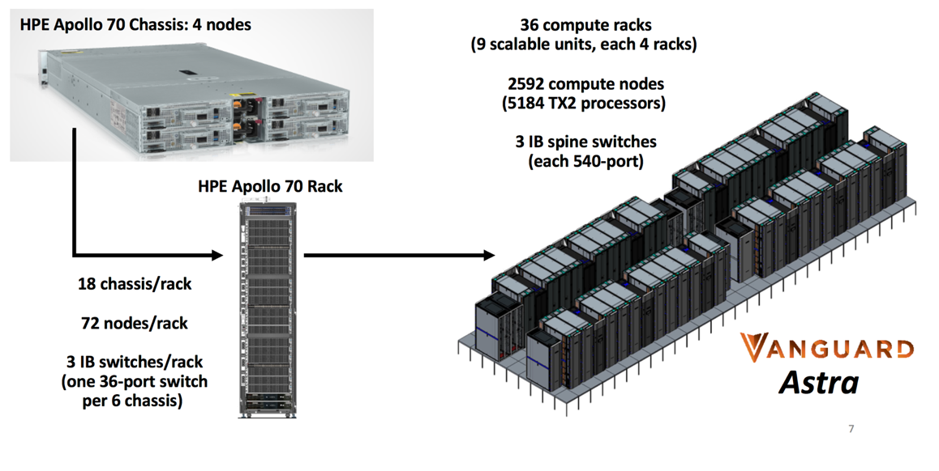
Astra – the First Petscale Arm based Supercomputer

Slide 33
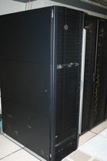
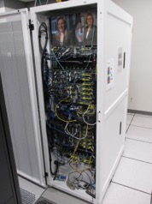
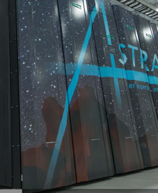
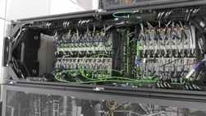

Sandia has a history with Arm - NNSA/ASC testbeds
2014
2017
2018
Hammer
Sullivan
Mayer
Vanguard/Astra
Applied Micro
X-Gene-1
47 nodes
Cavium ThunderX1
32 nodes
Pre-GA Cavium ThunderX2
47 nodes
HPE Apollo 70
Cavium ThunderX2
2592 nodes

Slide 34
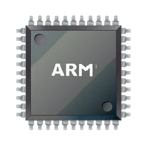


Advanced Trilab Software Environment (ATSE)
Advanced Tri-lab Software Environment
Sandia leading development with input from Tri-lab Arm team
Provide a user programming environment for Astra
Partnership across the NNSA/ASC Labs and with HPE
Lasting value for Vanguard effort
Documented specification of:
Software components needed for HPC production applications
How they are configured (i.e., what features and capabilities are enabled) and interact
User interfaces and conventions
Reference implementation:
Deployable on multiple ASC systems and architectures with common look and feel
Tested against real ASC workloads
Community inspired, focused and supported
Leveraging OpenHPC effort
ATSE
stack
ATSE is an integrated software environment for ASC workloads

Slide 35
Supercontainer Collaboration
Interface with key ST and AD development areas
Advise and support the container usage models necessary for deploying first Exascale apps and ecosystems
Initiate deep-dive sessions with interested AD groups
ExaLEARN or CANDLE good first targets
Activities which can best benefit from container runtimes
Develop advanced container DevOps models
Work with DOE Gitlab CI team to integrate containers into current CI plan
Leverage Spack to enable advanced multi-stage container builds
Integrate with ECP SDK effort to provide optimized container builds which benefit multiple AD efforts

Slide 36
Scalable R&D Activities
Several Topics:
Container and job launch, including integration with resource managers
Distribution of images at scale
Use of storage resources (parallel file systems, burst buffers, on-node storage)
Efficient and portable MPI communications, even for proprietary networks
Accelerators e.g. GPUs
Integration with novel hardware and systems software associated with pre-Exascale and Exascale platforms
Activities conducted in the context of interoperability
Portable solutions
Work for multiple container implementations
Multiple facilities at multiple scales

Slide 37
Future Integration
For project to be successful, need to provide support for deploying container runtimes at individual facilities
Facilities Integration ideas:
Help integrate with facilities on pre-Exa and Exa machine deployments
Include systems level support for efficient configuration, and interoperability across ECP
Demonstrate exemplar ECP application deployed with containers at scale
Work with HPC vendors today to ensure designs meet container criteria
Support upstream container projects when applicable (Docker, Singularity)

Slide 38
Training Education & Support
Containers are a new SW mechanism, training and education is needed to help ECP community to best utilize new functionality
Reports:
Best Practices for building and using containers
Taxonomy survey to survey current state of the practice
Training activities:
Run tutorial sessions at prominent venues
ISC, SC, and ECP annual meetings
Already have several activities underway
Online training and outreach sessions
Provide single source of knowledge for groups interested in containers

